Slide 1



Brian Sandoval
Governor
Richard Whitley
Director
State of Nevada
Department of Health and Human Services
Division of Public and Behavioral Health
Tobacco Control in Nevada
David S. Olsen, MPH
Policy and Systems Manager
June 14, 2018

Slide 2

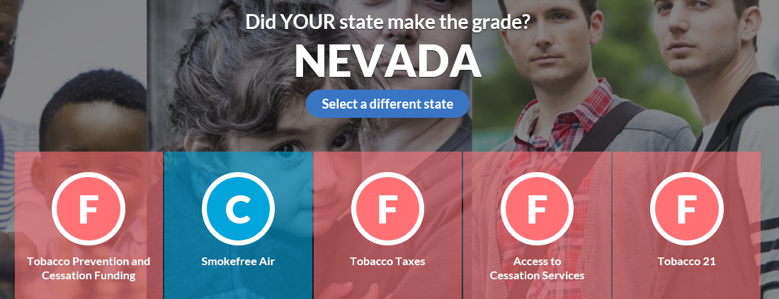
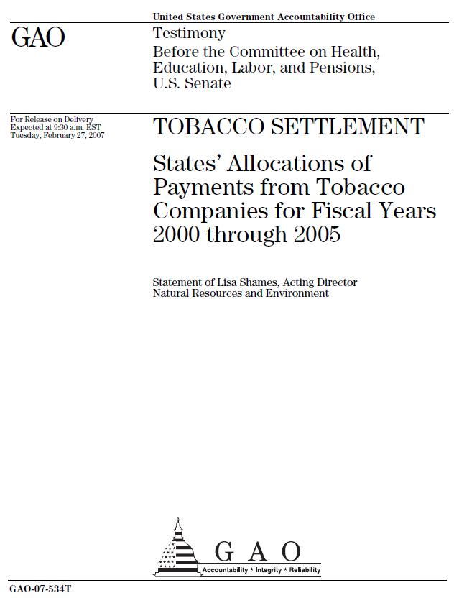

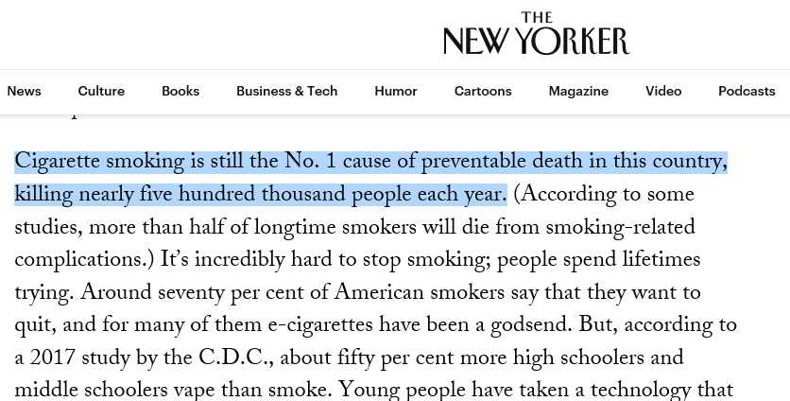

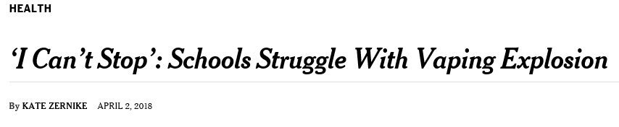

Why are we here?

Slide 3

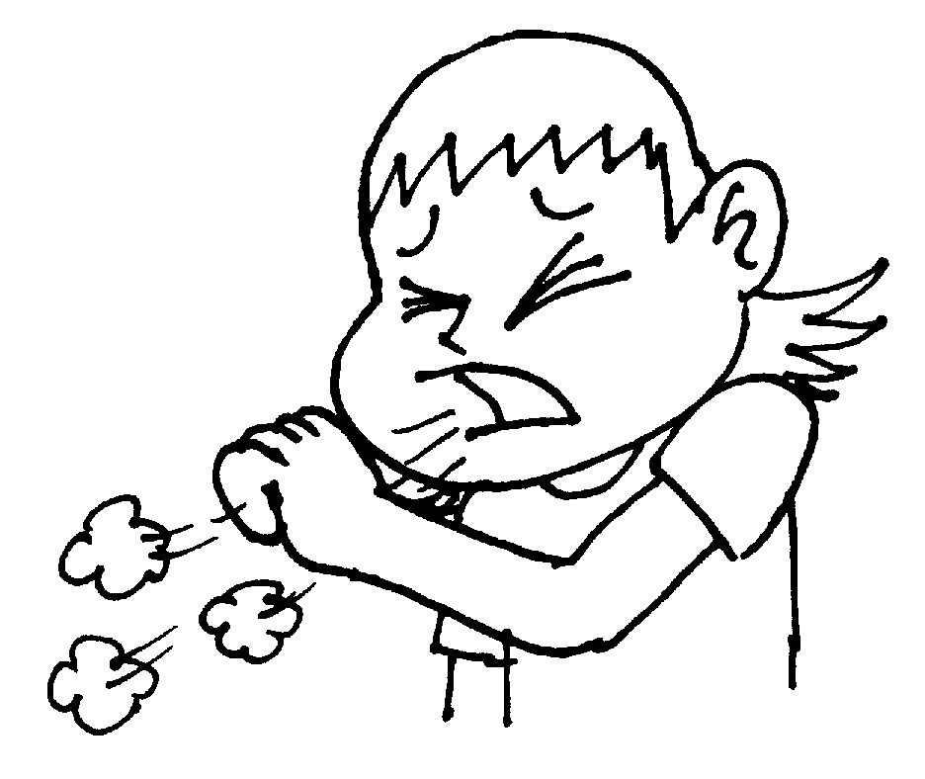

Tobacco Prevention & Control Goals
Prevent Initiation Among Youth and Young Adults
Eliminate Exposure to Secondhand Smoke
Promote Quitting Among Adults and Youth
Eliminate Disparities
#1
#2
#3

Slide 4

Nevada Tobacco Quitline
One of the most cost-effective preventive services
  $2-3 return for every $1 invested
  Quitters cost $541 less per quarter in health care costs, within 18 months of quitting, than those who continued smoking
Why Nevada will always need a quitline
  1-800-QUIT-NOW acts as a “hub” to connect clients to services
  Uninsured were 20 percent of callers in 2017
Sources:
Clear Way Minnesota. Return on Investment for Tobacco Cessation. Retrieved from: http://clearwaymn.org.s157839.gridserver.com/wp-content/uploads/2012/11/FINAL-ROI-Briefing-Sheet.pdf.
Medicaid.gov, Tobacco Cessation. Retrieved from: https://www.medicaid.gov/medicaid/quality-of-care/improvement-initiatives/tobacco/overview/index.html.

Slide 5

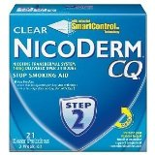
Nevada Tobacco Quitline
Moving Forward
  Improve service to clients with mental health conditions
  Increase quit rates by restoring and increasing the availability Nicotine Replacement Therapy
Quit Rate by Health Plan Type, 2016
Health Plan | Responder Quit Rate
Commercial Insurance | 29.8%
Medicaid | 19.6%
Medicare | 23.9%
Uninsured | 37.0%
Source:
2016 Nevada Quitline Outcomes Report

Slide 6
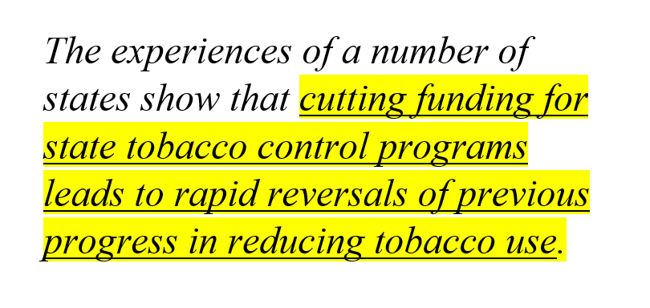
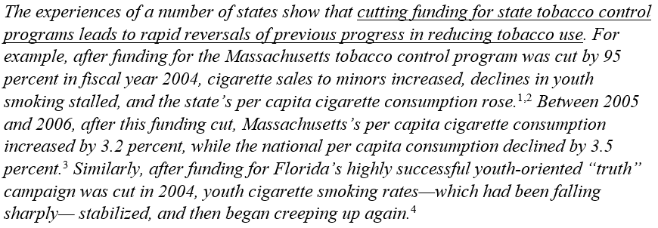
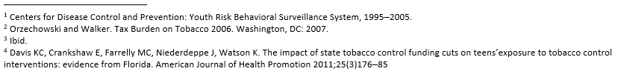
Best Practice and Evidence-Based

Slide 7
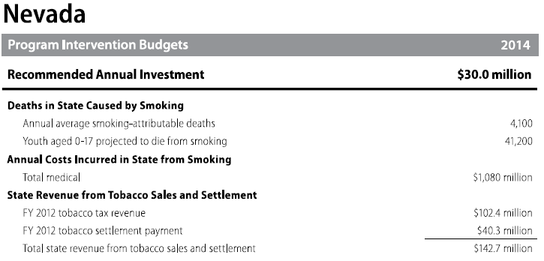

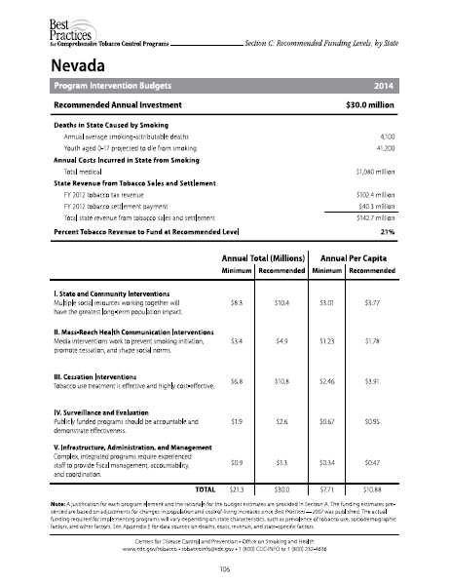
Best Practice and Evidence-Based

Slide 8
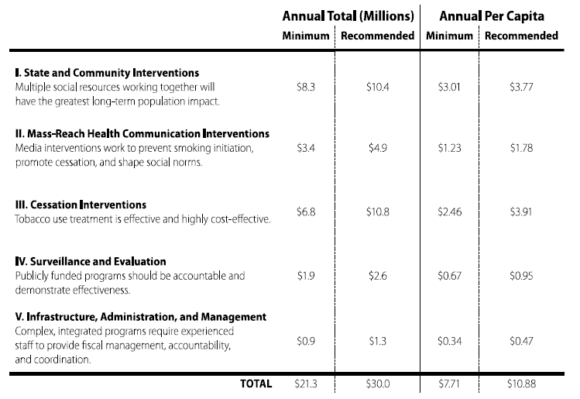
Best Practice and Evidence-Based

Slide 9
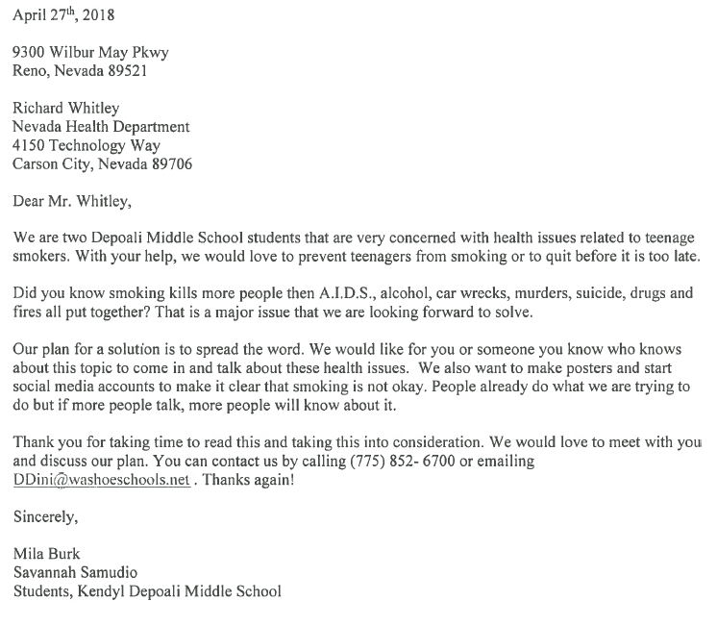
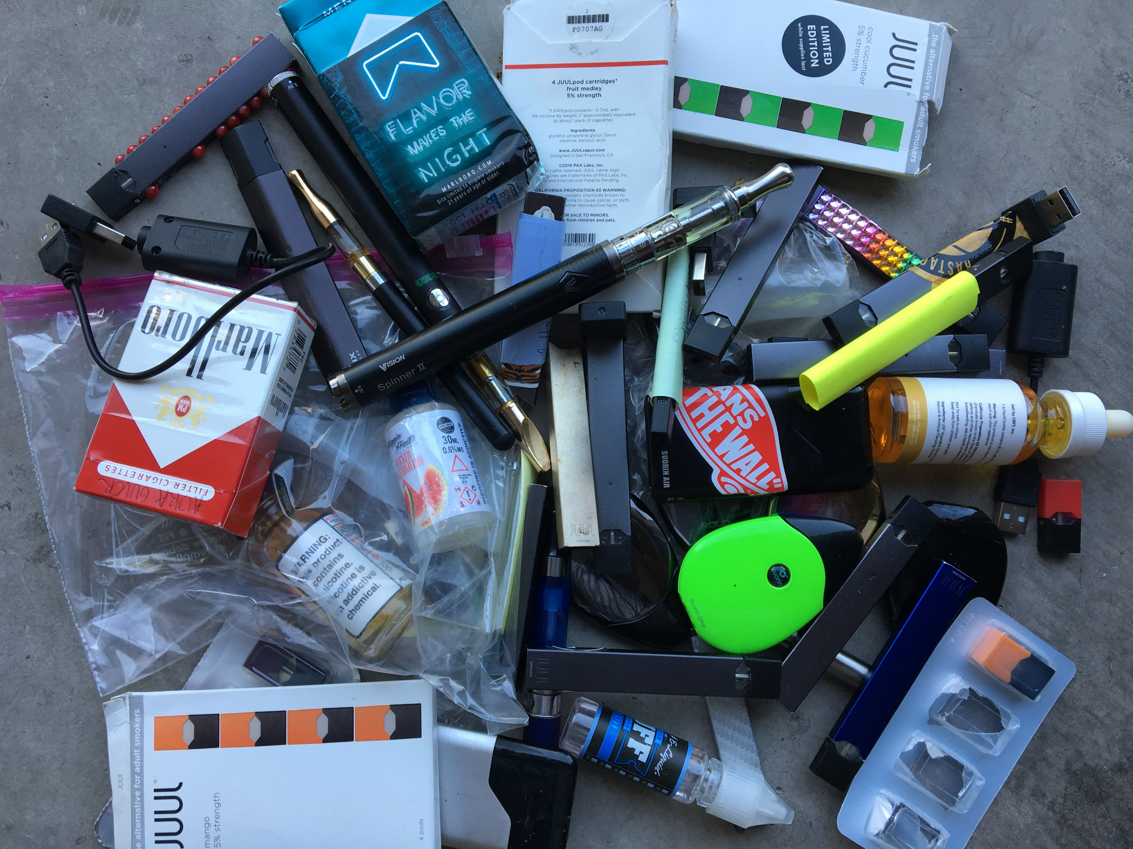
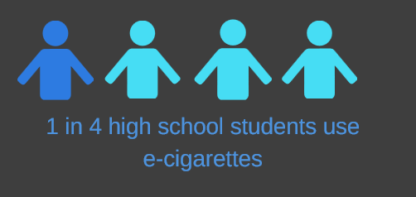
The Need for Increased Youth Prevention
Source:
2015 Nevada Youth Risk Behavior Surveillance System

Slide 10

Thank you!
David S. Olsen, MPH
Policy and Systems Manager
Division of Public & Behavioral Health
Chronic Disease Prevention and Health Promotion
DOLSEN@health.nv.gov
(775) 684-4237

